Slide 1
Pilotis
Most important point
Lifted the building off the ground
Free Ground Plan
Walls to designate space rather than structure
Demands of form over structure
Free Façade
Similar to Free Plan, but in elevation
Independence of opening from structure
Ribbon Window
Dependent on Free Façade
Even lighting throughout contained room
Roof Garden
Reintroduction of nature into the city
Provide insulation for flat concrete roof
Five Points of a New Architecture (1926)

Slide 2
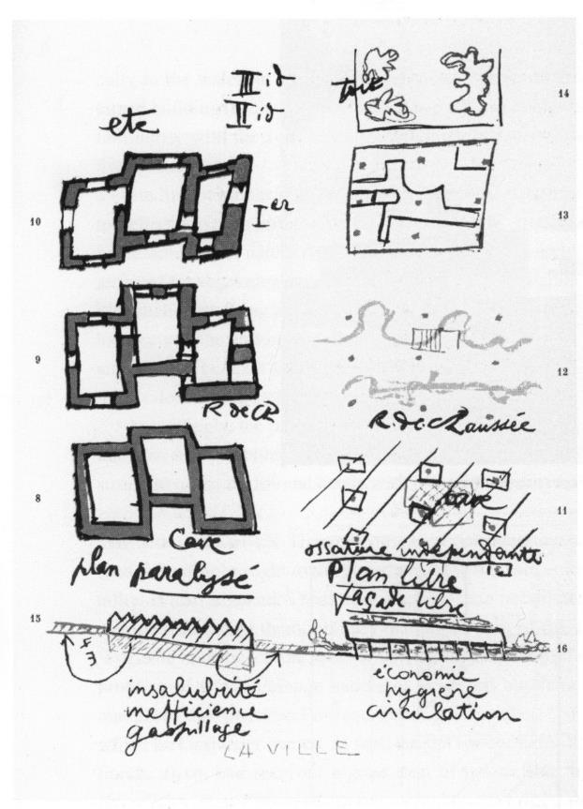
Pilotis
Most important point
Lifted the building off the ground
Free Ground Plan
Walls to designate space rather than structure
Demands of form over structure
Free Façade
Similar to Free Plan, but in elevation
Independence of opening from structure
Ribbon Window
Dependent on Free Façade
Even lighting throughout contained room
Roof Garden
Reintroduction of nature into the city
Provide insulation for flat concrete roof
Five Points of a New Architecture (1926)

Slide 3
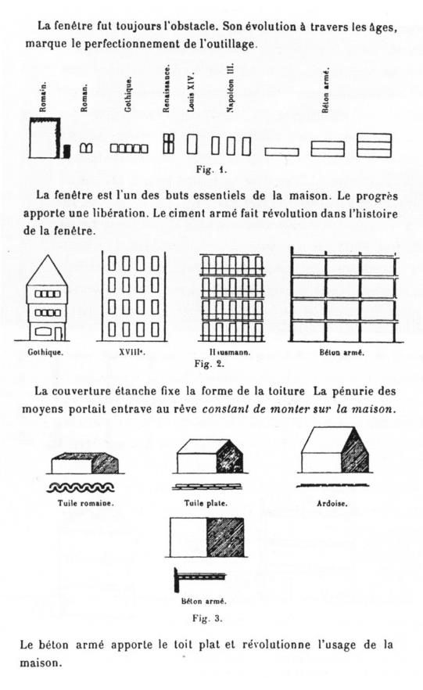
Pilotis
Most important point
Lifted the building off the ground
Free Ground Plan
Walls to designate space rather than structure
Demands of form over structure
Free Façade
Similar to Free Plan, but in elevation
Independence of opening from structure
Ribbon Window
Dependent on Free Façade
Even lighting throughout contained room
Roof Garden
Reintroduction of nature into the city
Provide insulation for flat concrete roof
Five Points of a New Architecture (1926)

Slide 4
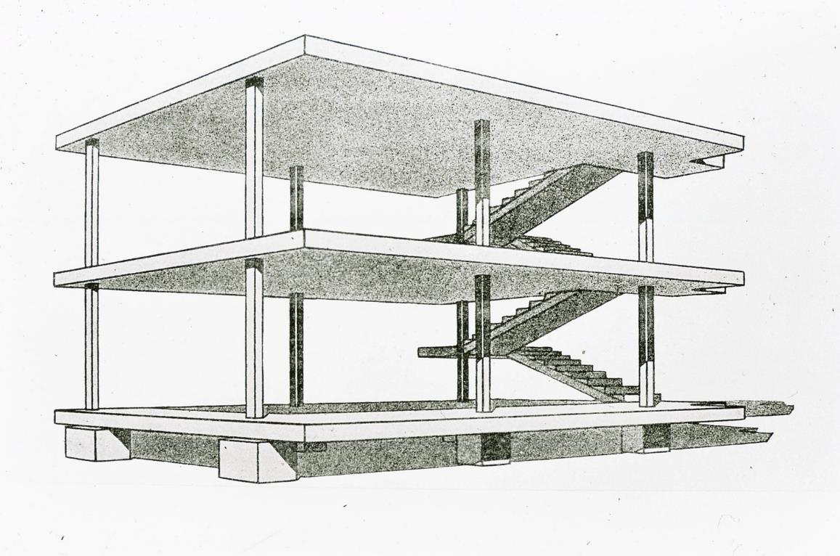
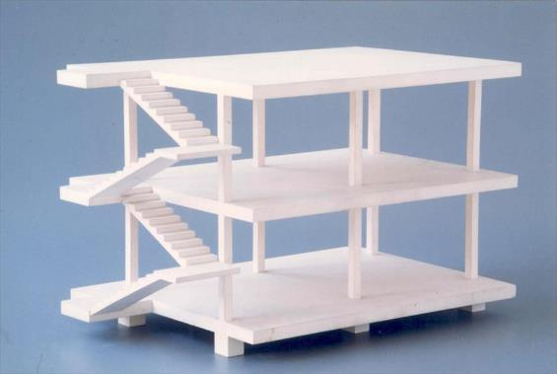
Dom-ino prototype, 1914-15, 1920s
Notes:
Maison Dom-ino [1914-15]
Domus (Latin) + Dominoes (b/c they could be connected)
Formal generator
Influenced by technology + social
Rapid construction
Generic construction (build before use)
Removed the fill from the frame (more universal)
3 horizontal slabs, supported by square sectional posts of concrete, lower level lifted from the ground on concrete blocks
‘pure’ structural idea
Cantilever (to allow for curtain wall)
Fenestration could go over corners (which were traditionally reserved for heavy structures)
Allowed for the Free Plan, Free Façade

Slide 5
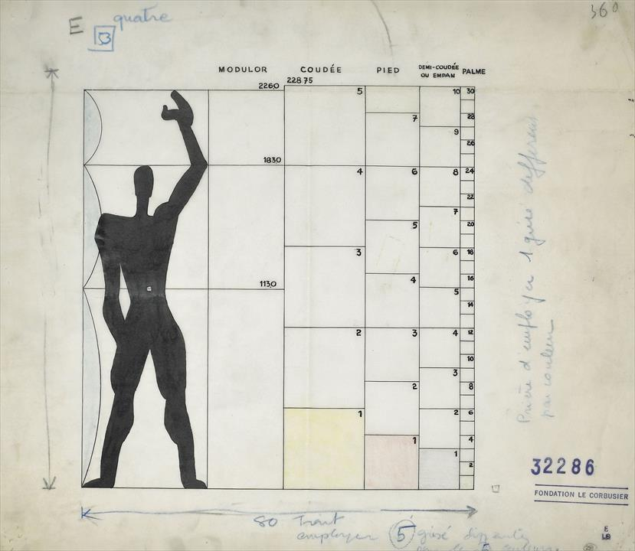
‘Le Modulor’
Notes:
Modulor
6’ idealized proportions of man
To provide building with a synthesis between Metric and Imperial
Units based off of the human body
(Coudée = ‘Cubit’ in English)

Slide 6
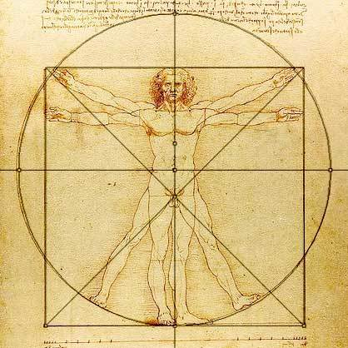
‘Le Modulor’
Notes:
Recalling his purist approach to painting – idealized and mathematicised ratios
Recalls Vitruvian Man (Da Vinci)
Belief in a ‘grand equation’, whereby ‘man’ was endowed with divine proportions, and so buildings should respond to these ratios

Slide 7
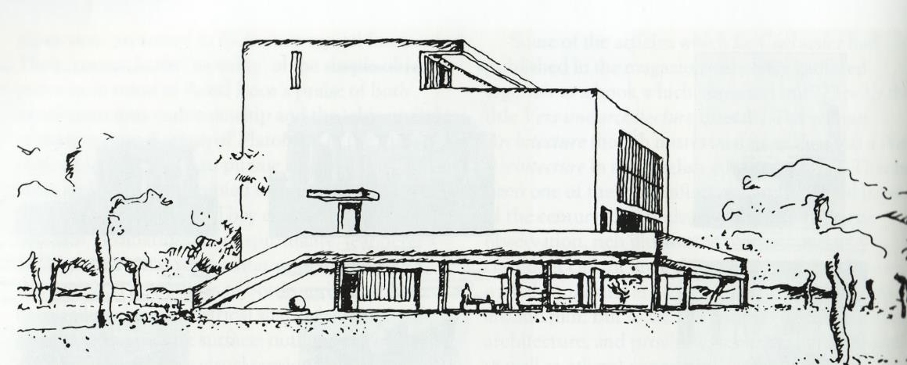
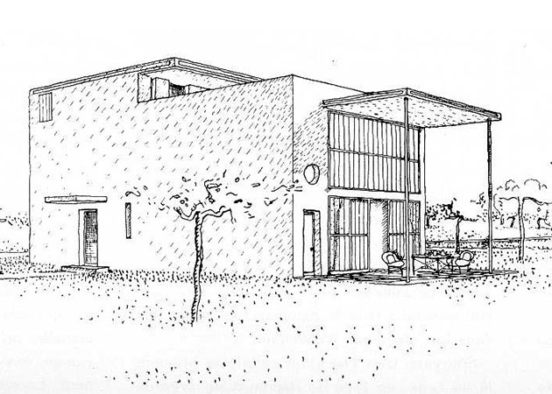
Villa/Maison Citrohan
Notes:
Villa/Maison Citrohan
Post-WWI attempt at making affordable and aesthetically pleasing housing
Mass-produced
Reinforced concrete
Single or single family housing
Preceding his 5 Points, so we don’t see everything here yet
Pilotis
Not shown here, but intended to have a roof garden

Slide 8
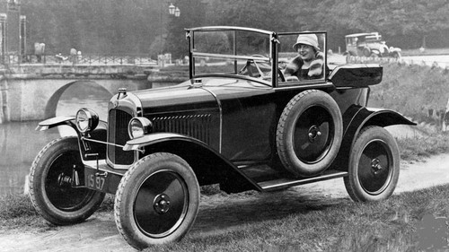
Villa/Maison Citrohan
Notes:
Named to be like the car company Citroën… important technologically
Machine-like, efficient
Inspired by assembly-line manufacturing

Slide 9
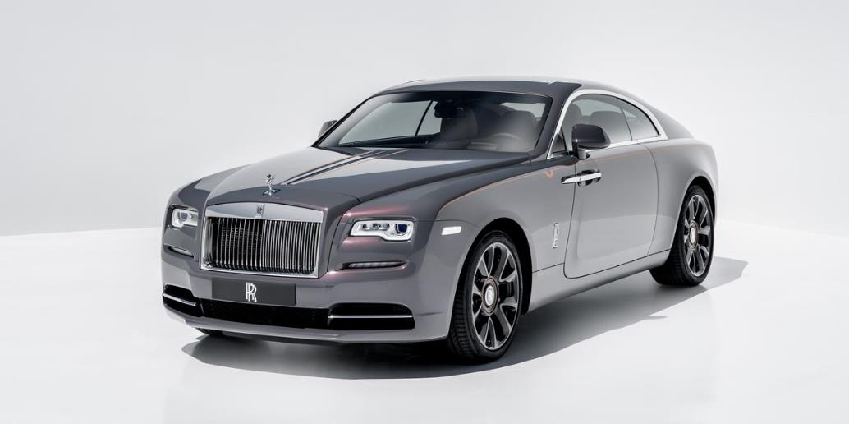
Villa/Maison Citrohan
Notes:
- Citrohan not a Rolls Royce of today

Slide 10
Villa/Maison Citrohan
Notes:
… wasn’t supposed to be luxury

Slide 11
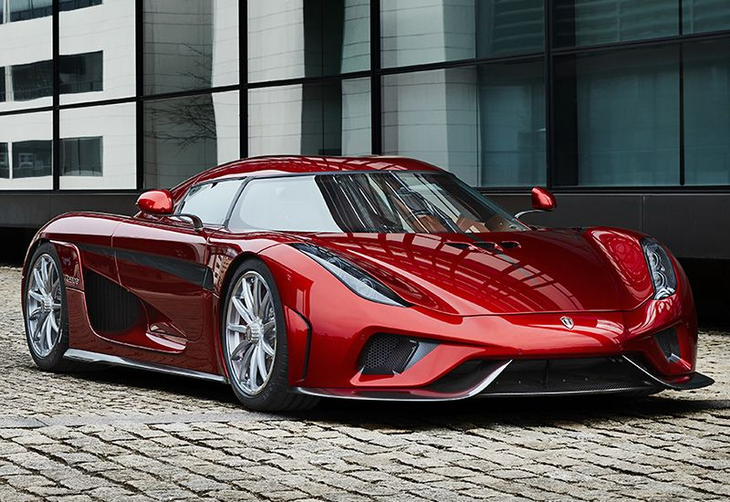
Villa/Maison Citrohan
Notes:
- Nor like a high end sportscar

Slide 12
Villa/Maison Citrohan

Slide 13
Villa/Maison Citrohan
Notes:
But maybe the best comparison with today’s cars would be a lower range Tesla
Technologically advanced, and designed to be generally attainable by the middle class and above

Slide 14
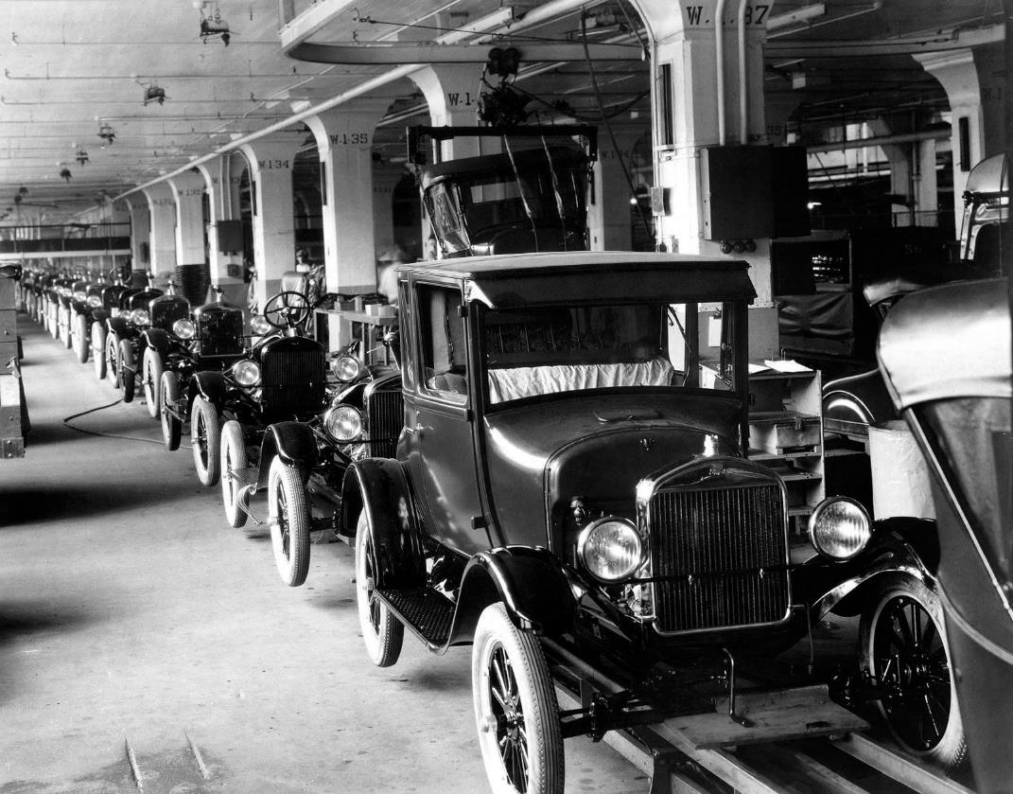
Villa/Maison Citrohan
Notes:
Going back to his time, the car was incredibly important not only for what it was, but how it was made
For LC, the car fundamentally changed how we should think about design, production, and living

Slide 15
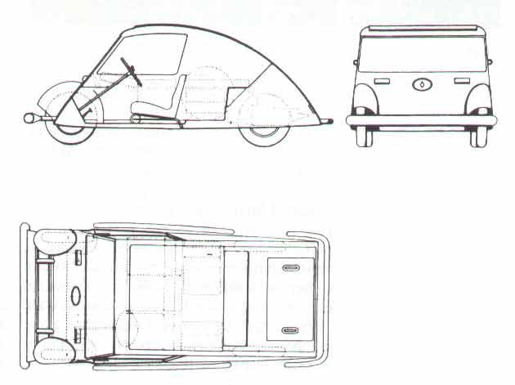
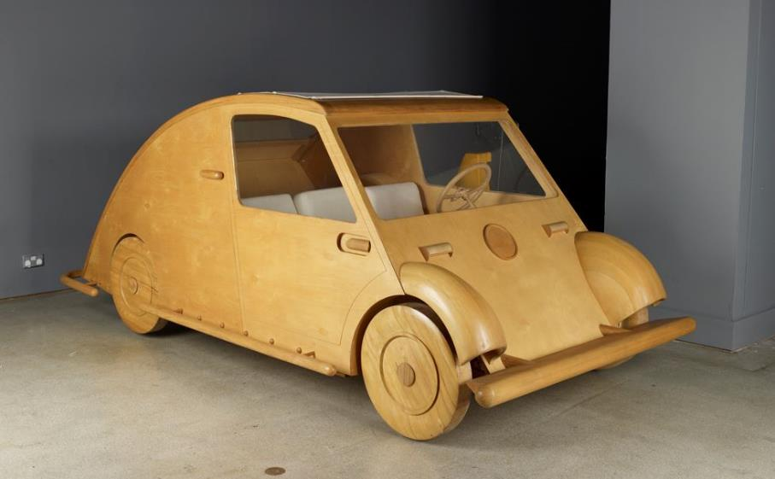
Voiture Minimum (1924)
Notes:
Misc (Car, Voiture Minimum)
Designed for a competition
Société des Ingénieurs de l’Automobile
A ‘people’s car’
He didn’t just like cars, but the idea of the car was integral to his idea of architecture, insofar as they were both designed machines for living

Slide 16
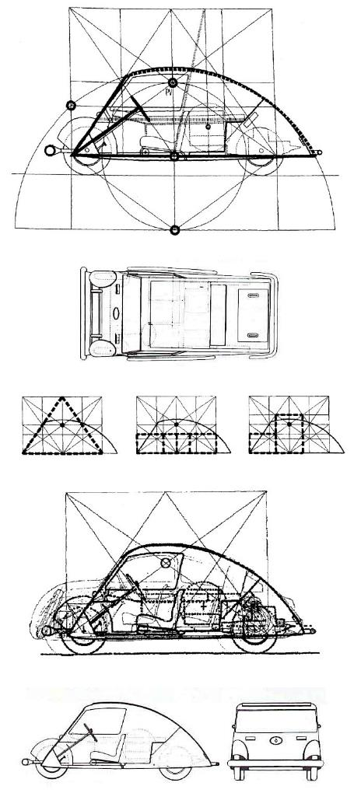
Voiture Minimum (1924)

Slide 17
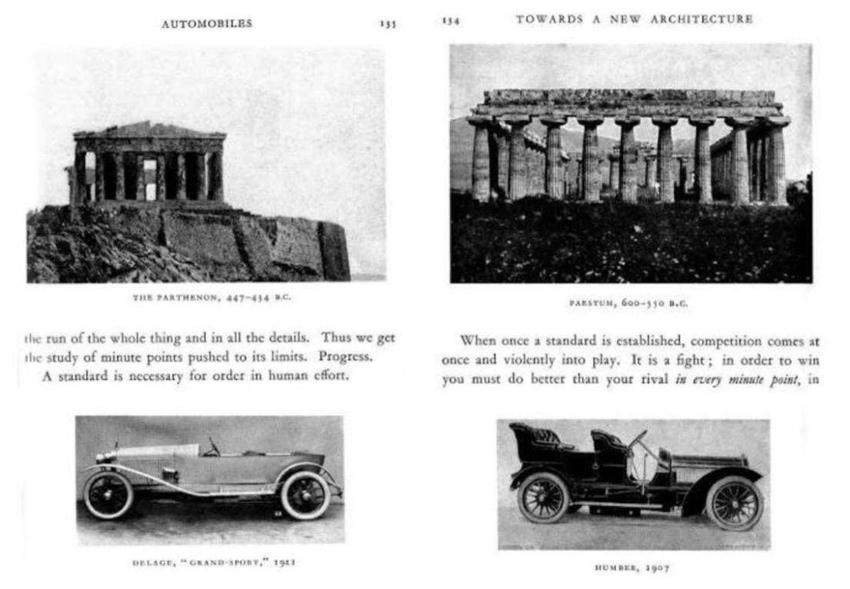
Voiture Minimum (1924)
Notes:
Very much a Renaissance approach

Slide 18
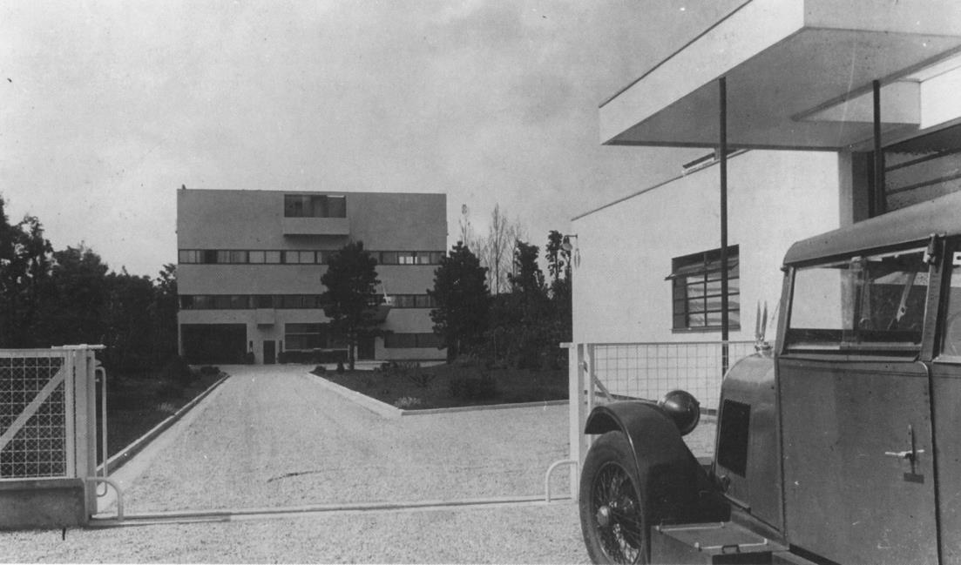
Voiture Minimum (1924)
Villa Stein, Garches, France (1928)
Notes:
LC often insisted that the official photographs of his buildings have a modern sleek car in the foreground

Slide 19
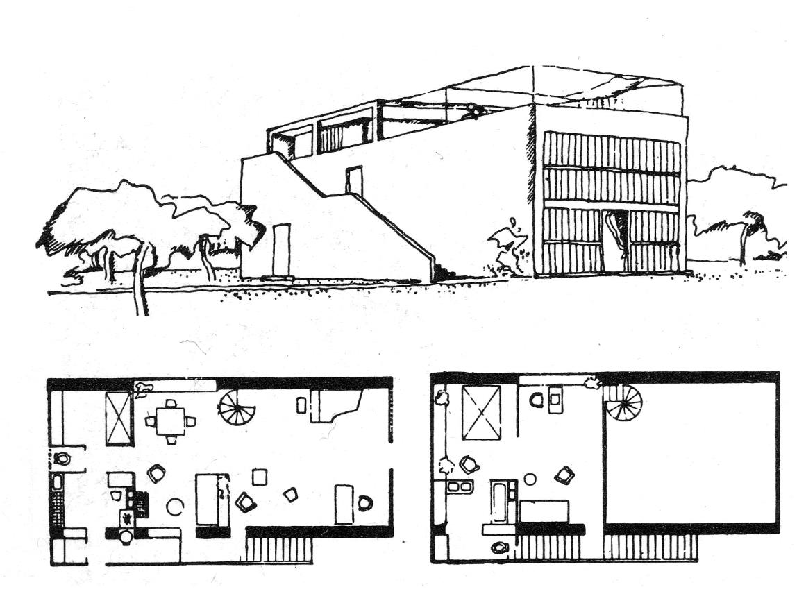
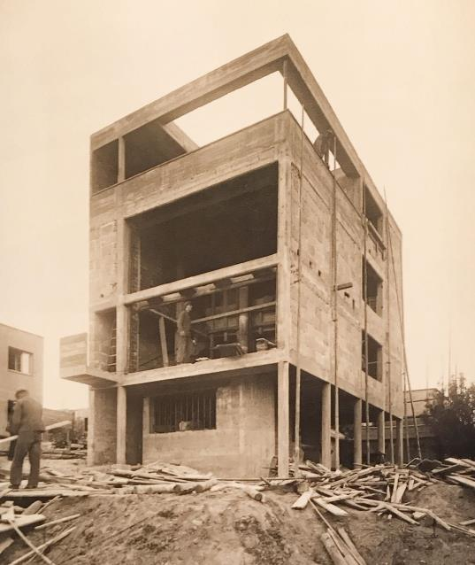
Villa/Maison Citrohan
Notes:
- Example of construction of a Villla Citrohan… was supposed to be fast, efficient, and ‘engineered’ for living

Slide 20
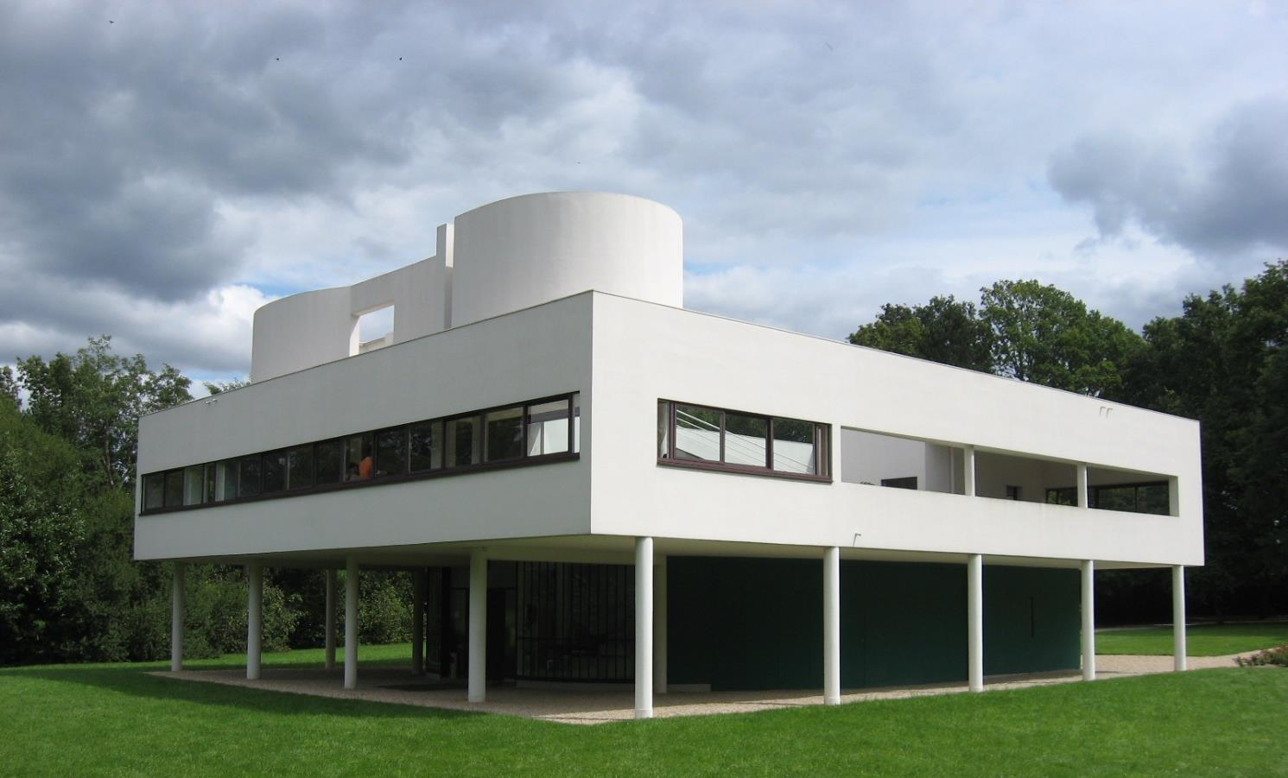
Villa Savoye, Poissy (near Paris), France (1929 – 31)
Notes:
Villa Savoye [1928-1931], Poissy (Paris)
Contrary to the Villa Citrohan, the Villa Savoye should be thought of as a much higher-end implementation of his principles
One of LC’s most well-regarded works
Exemplar of his 5 Points

Slide 21
Video shown in class:
https://www.youtube.com/watch?v=BsIO0gna0M8&ab_channel=clemencerigaud

Slide 22
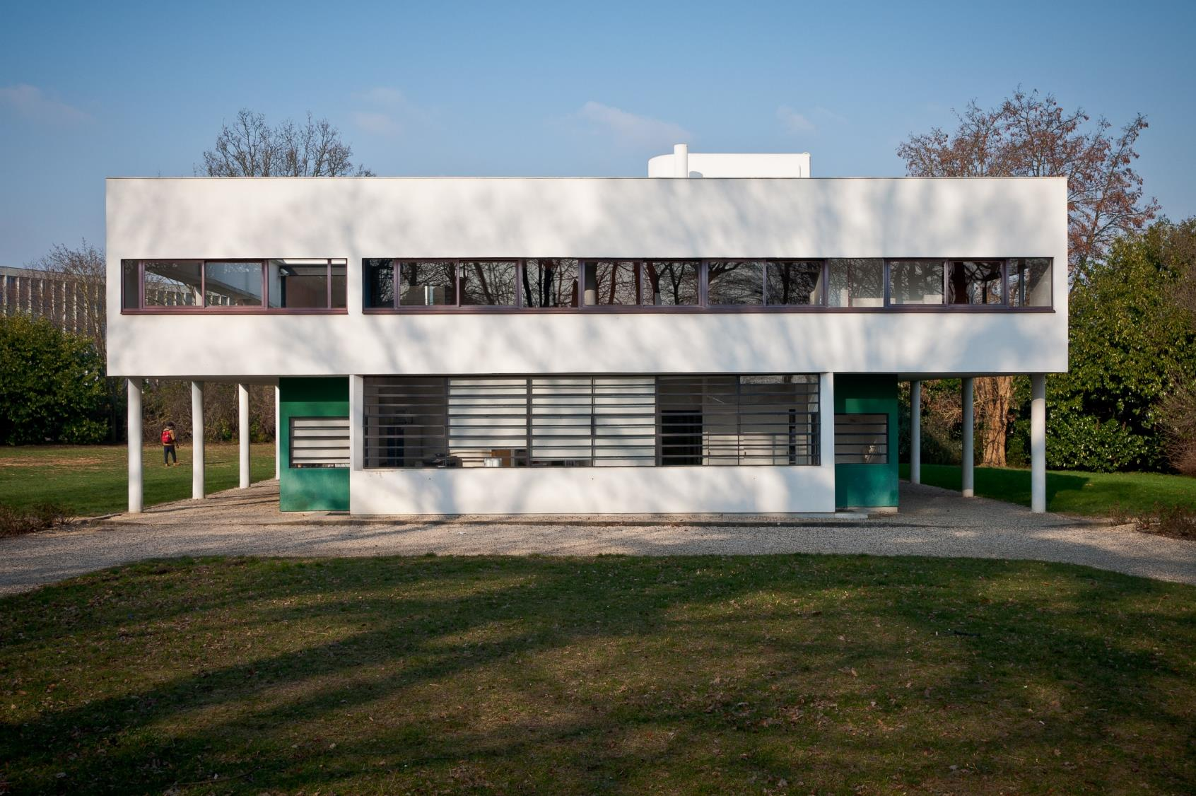
Villa Savoye, Poissy (near Paris), France (1929 – 31)
Notes:
Paradigm of the ‘International Style’
Like many of the paradigmatic modernist houses, VS was intended to be a summer retreat/weekend residence

Slide 23
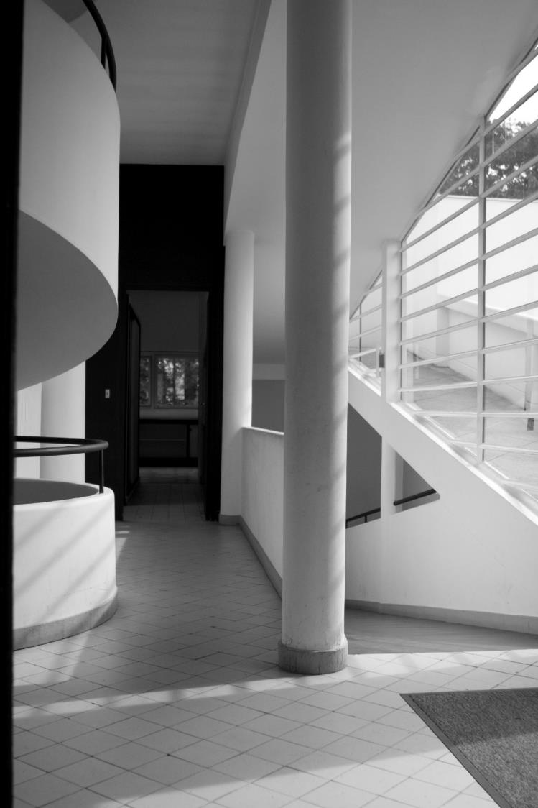
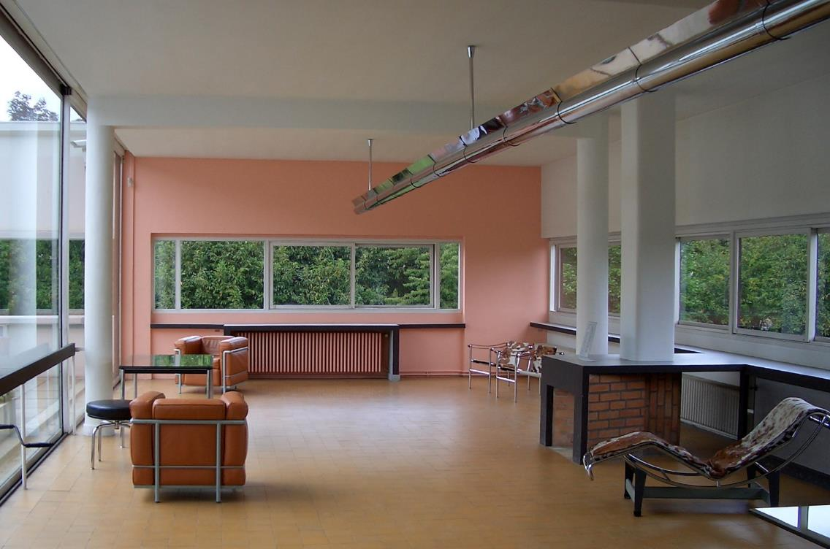
Villa Savoye, Poissy (near Paris), France (1929 – 31)
Notes:
Was given veritable carte blanche in the design by the clients
Can be though of as a box floating on pilotis, with a ramp (ground floor gravel driveway) running right through

Slide 24
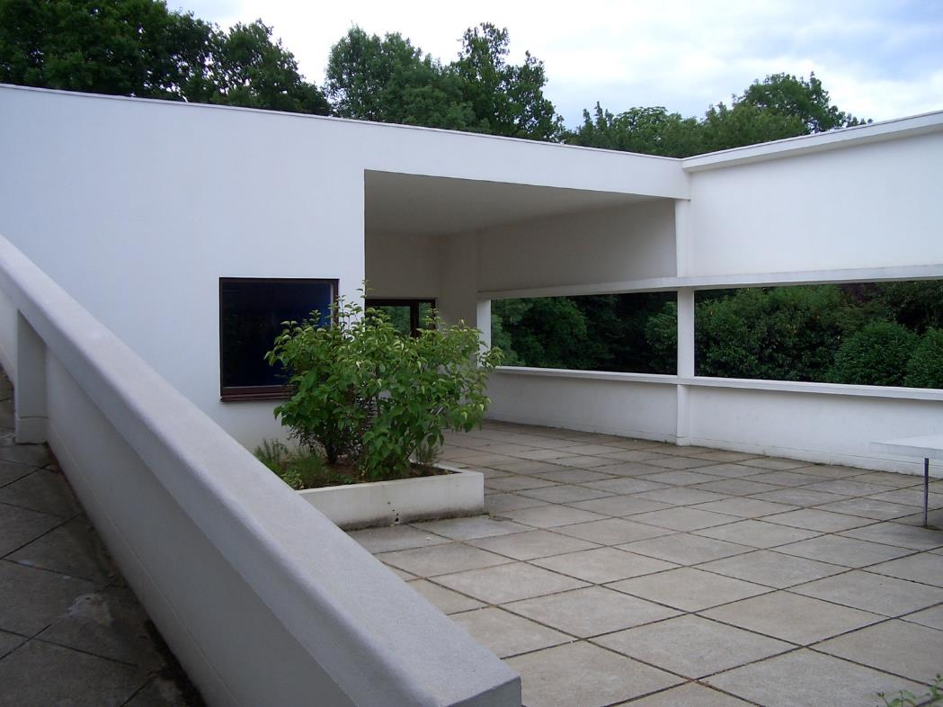
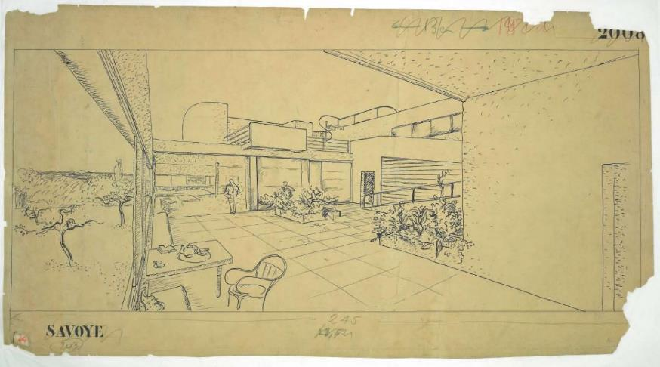
Villa Savoye, Poissy (near Paris), France (1929 – 31)
Notes:
Roof Garden

Slide 25
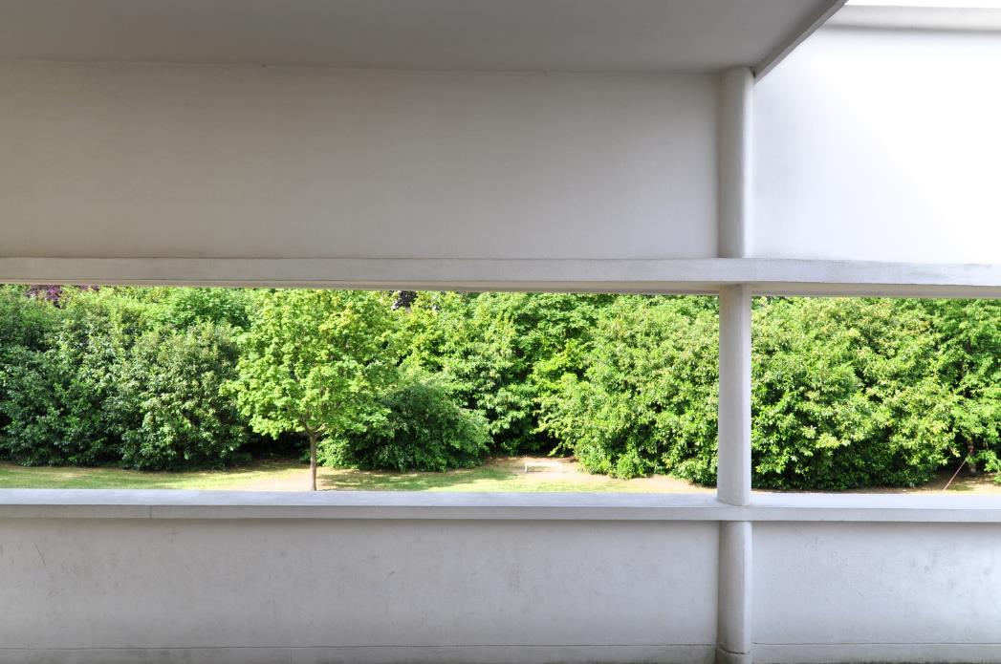
Villa Savoye, Poissy (near Paris), France (1929 – 31)
Notes:
Ribbon Window
Nature within architecture

Slide 26
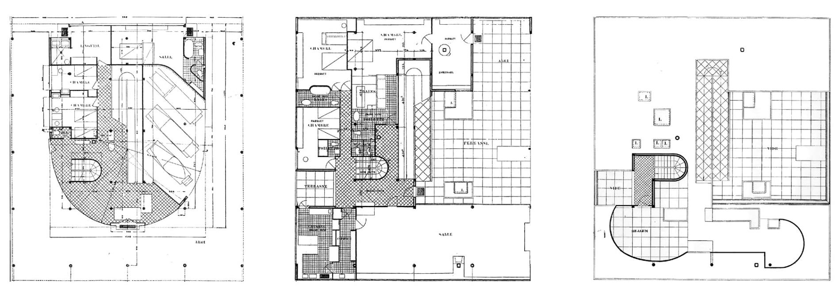
Villa Savoye, Poissy (near Paris), France (1929 – 31)
Notes:
Ground floor plan super important
Showing how columns and walls were independent of each other
Columns Generic – allowed for multiple configurations for living… didn’t get in the way

Slide 27
Ville Contemporaine
City for 3 million inhabitants
1922
Plan (Ville) Voisin
Plan of Neighbors
1925
Ville Radieuse
Notes:
LC developed a number of urban design schemes – you don’t have to be able to distinguish one from the other, but just recall these 3 projects
It’s really with his urban designs that we see how forceful the Modernist project was, and it was largely these kinds of projects (rather than building designs) that faced heavy reaction in the decades to follow

Slide 28
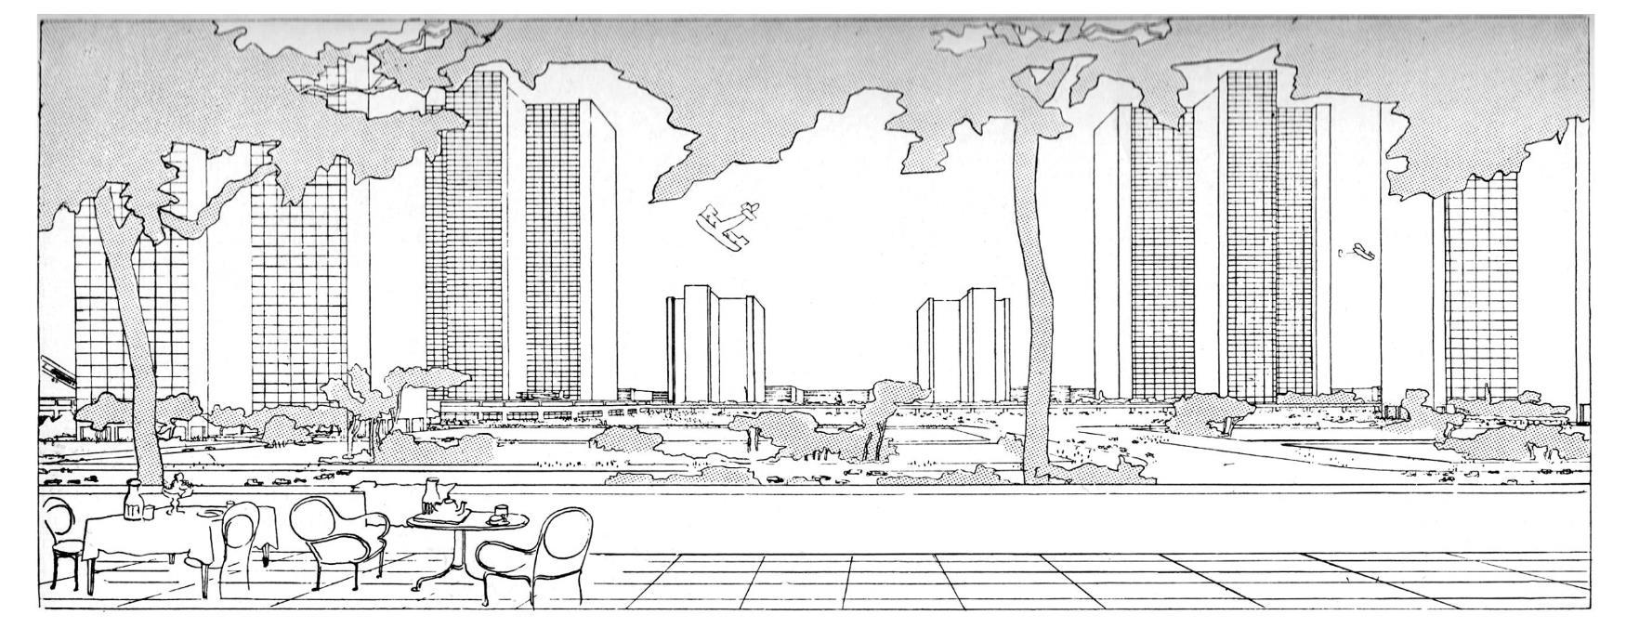
Ville Contemporaine (1922)
City for 3 million inhabitants
Notes:
Ville Contemporaine [City for 3 million inhabitants] (1922)
A total theory for all the processes of living, working, and industry
Decongestion of the city centres
Criticized NYC skyscrapers for being too small and too close to each other

Slide 29
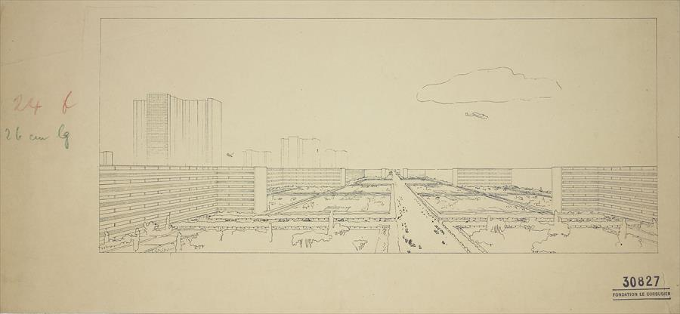
Ville Contemporaine (1922)
City for 3 million inhabitants
Notes:
Increase in density
Enlargement of infrastructure
Enlargement of landscaping

Slide 30
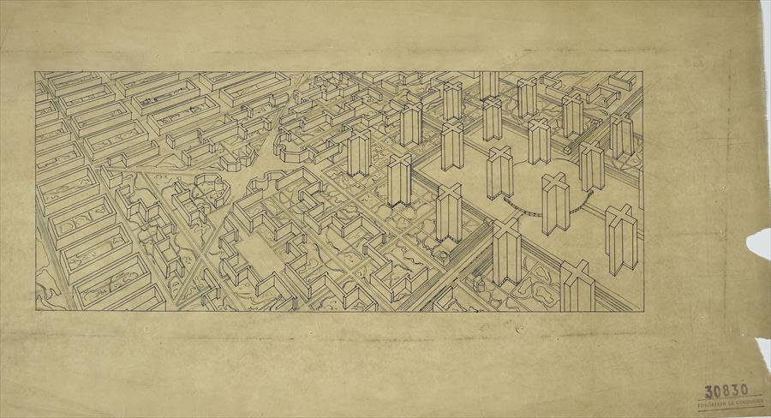
Ville Contemporaine (1922)
City for 3 million inhabitants

Slide 31
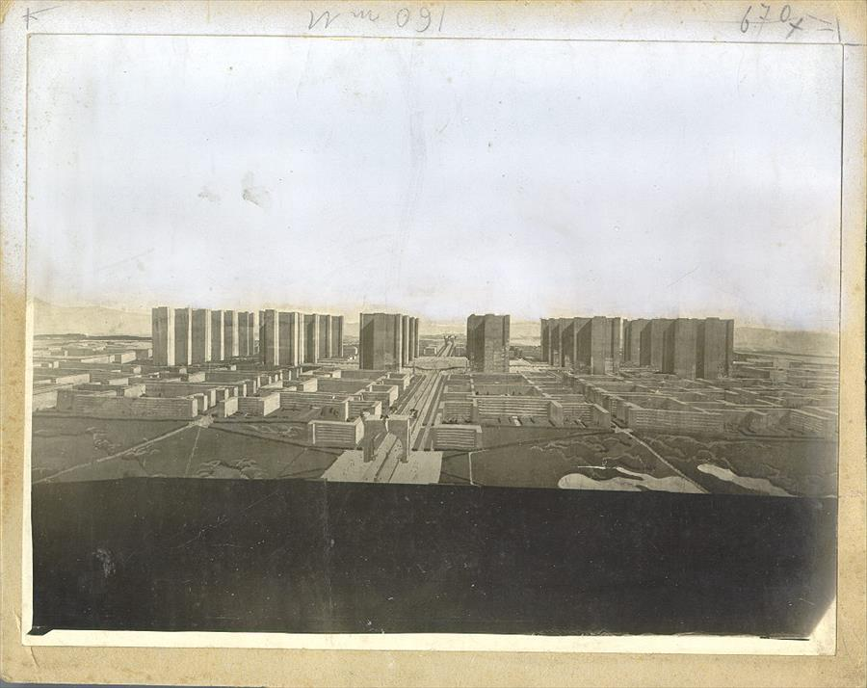
Ville Contemporaine (1922)
City for 3 million inhabitants
Notes:
24 skyscrapers – supposed to be the ‘brains’ of the city
Technocrats, managers, bankers
Central station - subterranean
The rest of the plan with high-density residential blocks, surrounded by landscaping
The lower income suburbs were farther away from the center

Slide 32
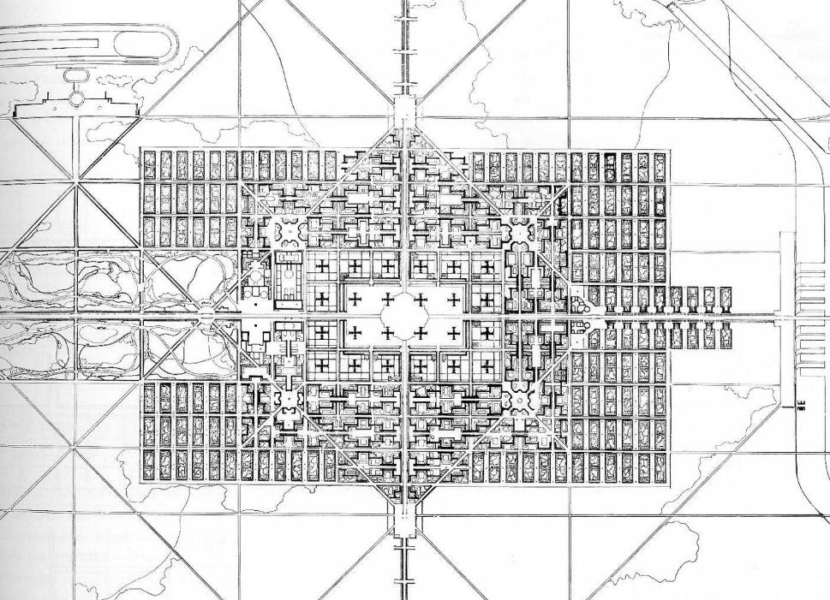
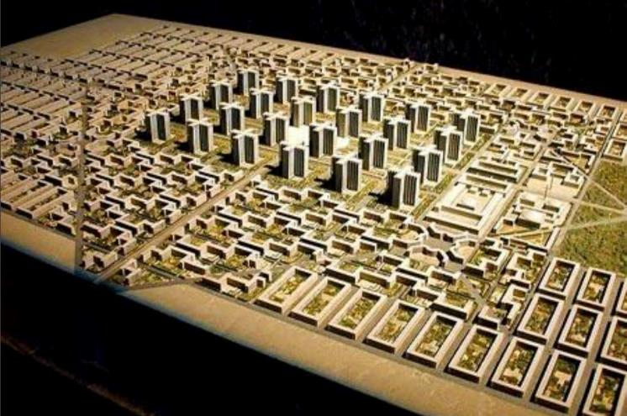
Ville Contemporaine (1922)
City for 3 million inhabitants
Notes:
Traffic to be removed from pedestrians with pilotis of building
Embracing technology and industry with clean air, separating of the automobile with pedestrians
The city to become a vast park

Slide 33
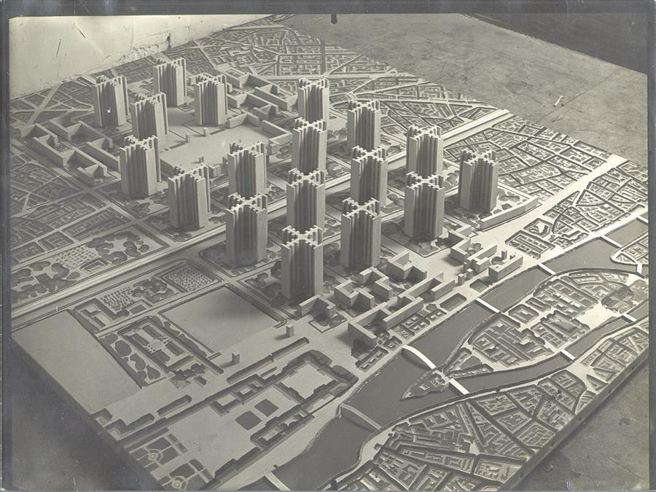
Plan Voisin, Paris (1925)
Notes:
Plan Voisin (1925)
Extension of the Ville Contemporaine, but proposed razing a major part of the city of Paris
Intended to clean up the city
Never fully considered

Slide 34
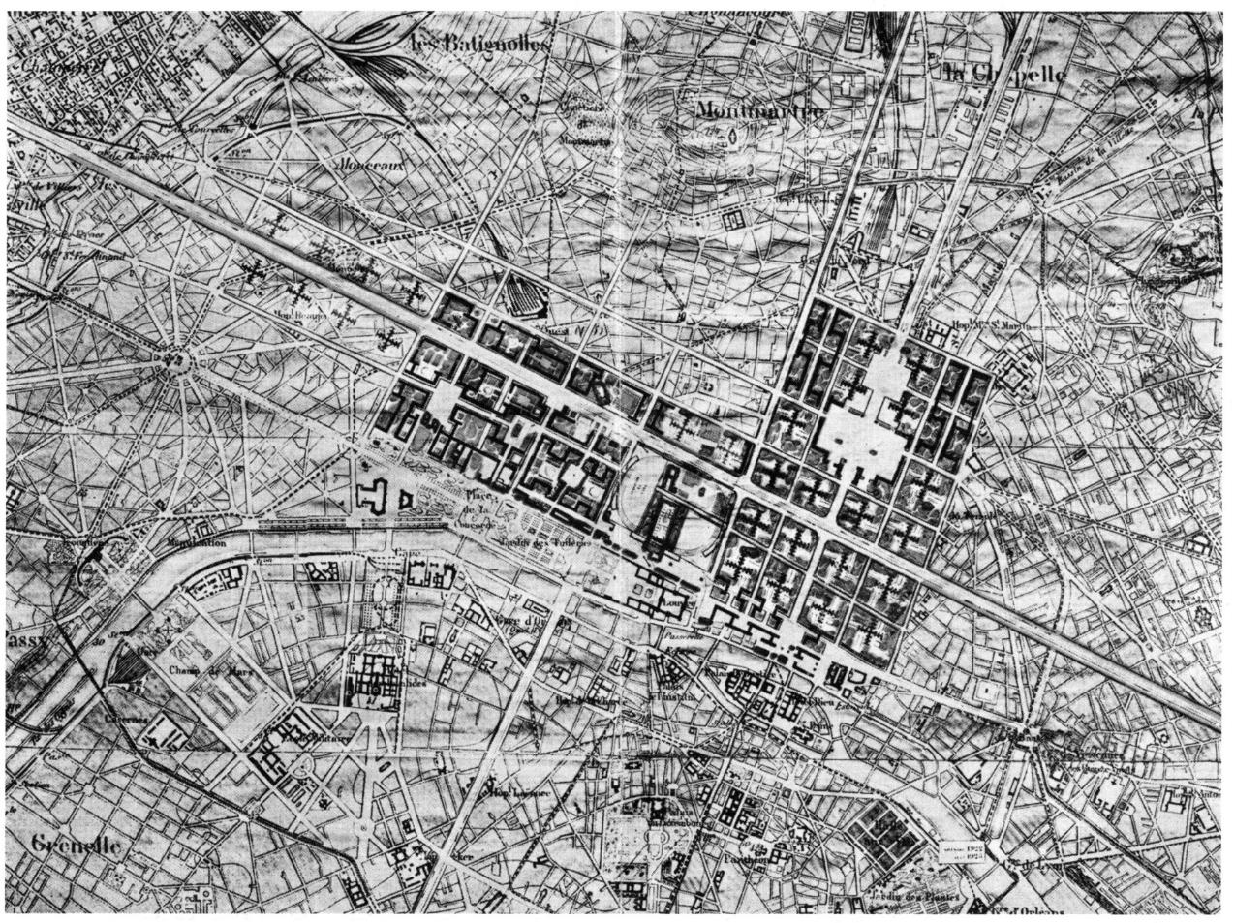
Plan Voisin, Paris (1925)

Slide 35
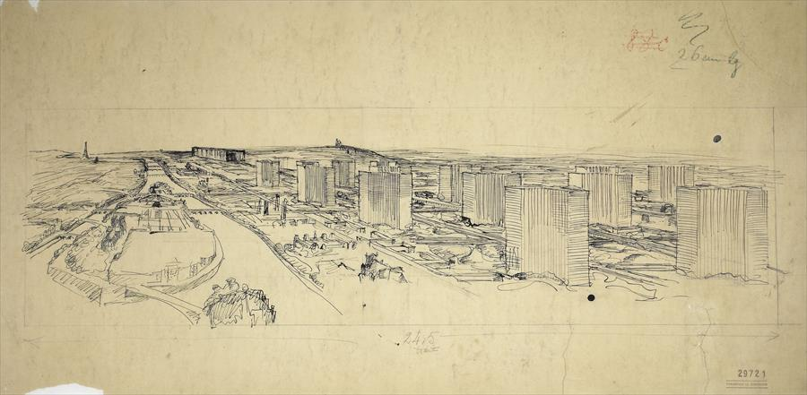
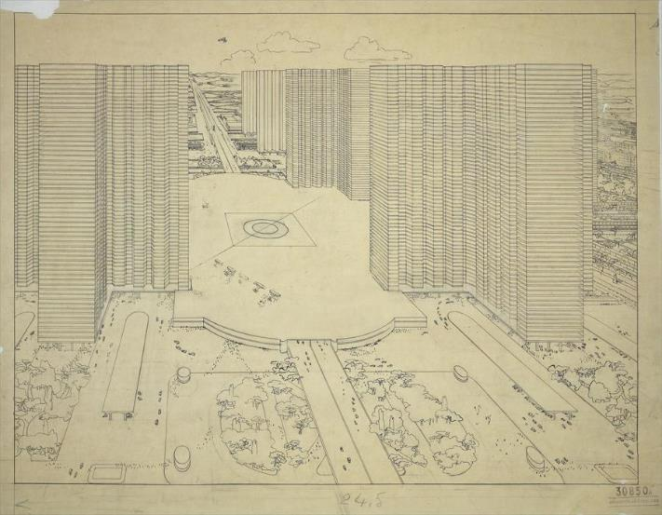
Plan Voisin, Paris (1925)
Notes:
Landing strip in the middle (you can see airplanes)

Slide 36
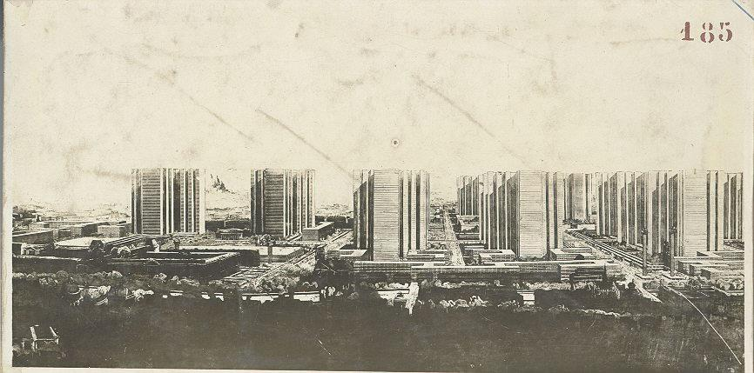
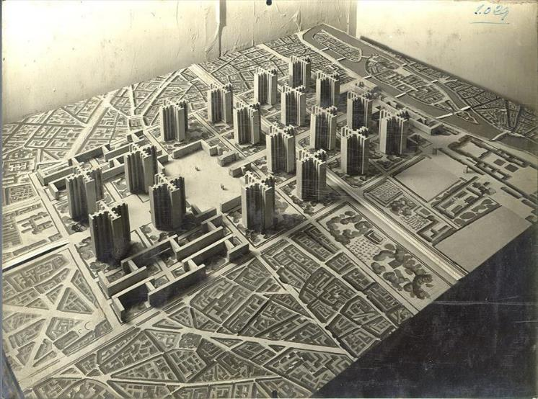
Plan Voisin, Paris (1925)

Slide 37
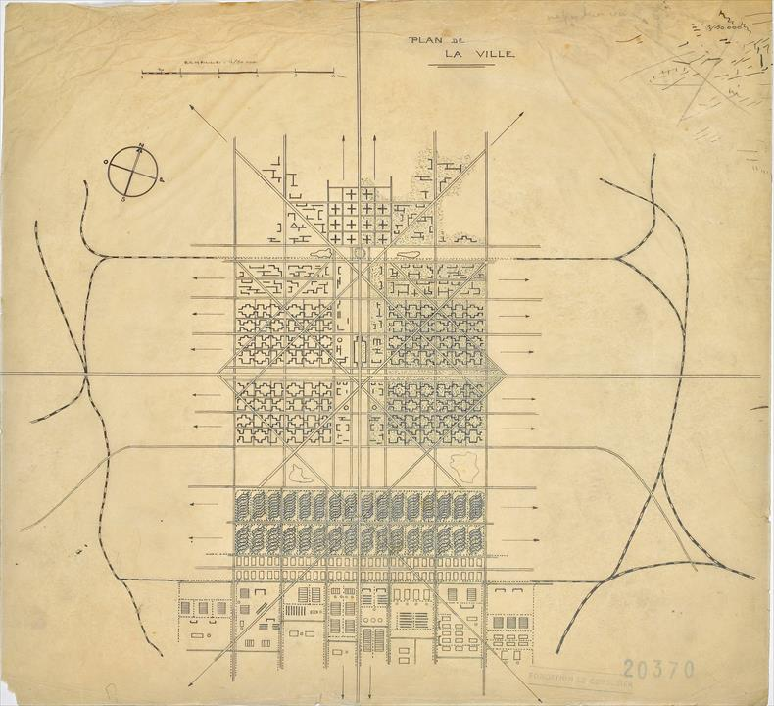
Ville Radieuse (1935)
‘Radiant City’
Notes:
Plan Radieuse (1935)
We see a reconsideration, a critique of his original plans
Residences no longer separated by strict hierarchies
‘Brain centers’ no longer occupy the center, but zoning is put into effect
Possible lateral extension

Slide 38
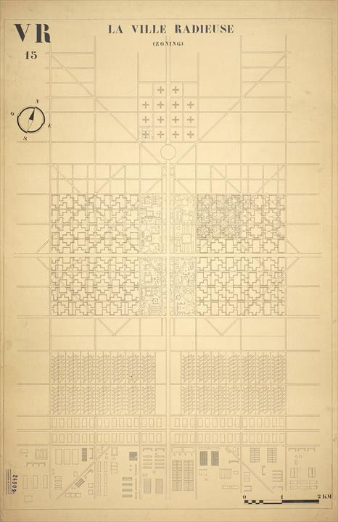
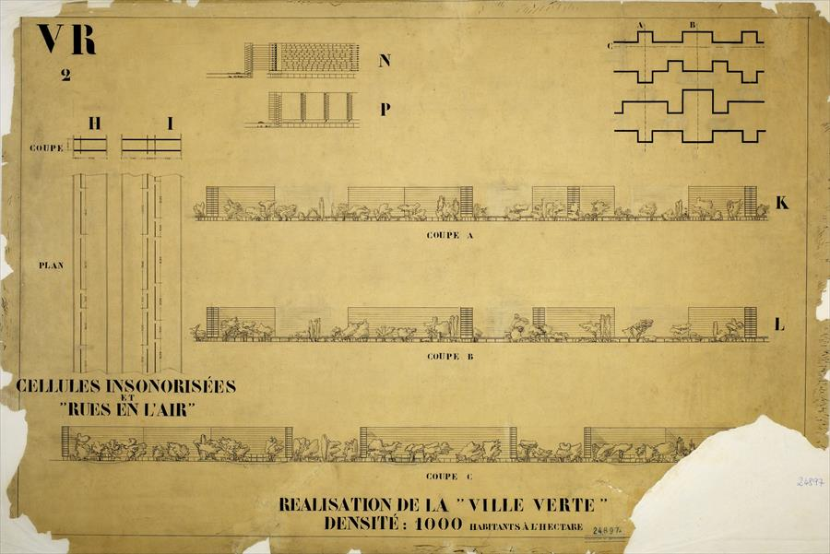
Ville Radieuse (1935)
‘Radiant City’
Notes:
Based much more on community
We can see the relationship between the Unite d’Habitation (forthcoming) and the residential blocks
No site, and was intended as an urban paradigm

Slide 39
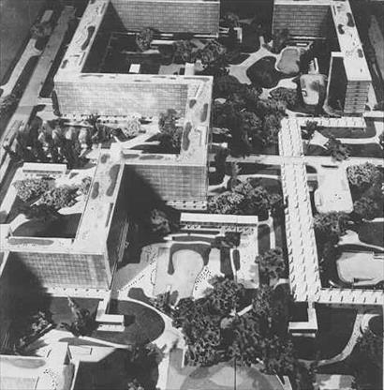
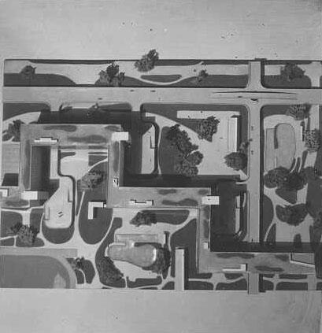
Ville Radieuse (1935)
‘Radiant City’
Notes:
Continued the basic concept of ‘Air, Space, Green’, while embracing technology and mechanization, and contemporary labor
Ultimately many variations of his many urban schemes, so not so much about precise design but about establishing urban policy, priorities

Slide 40
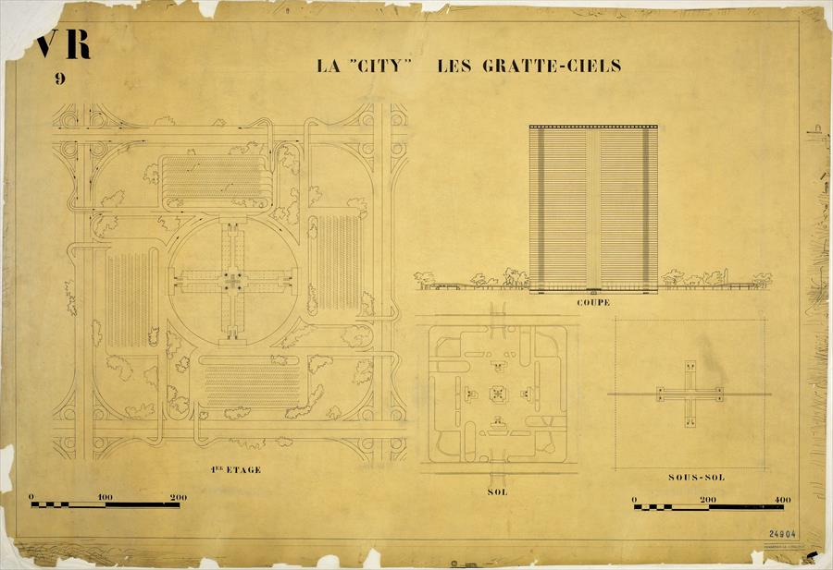
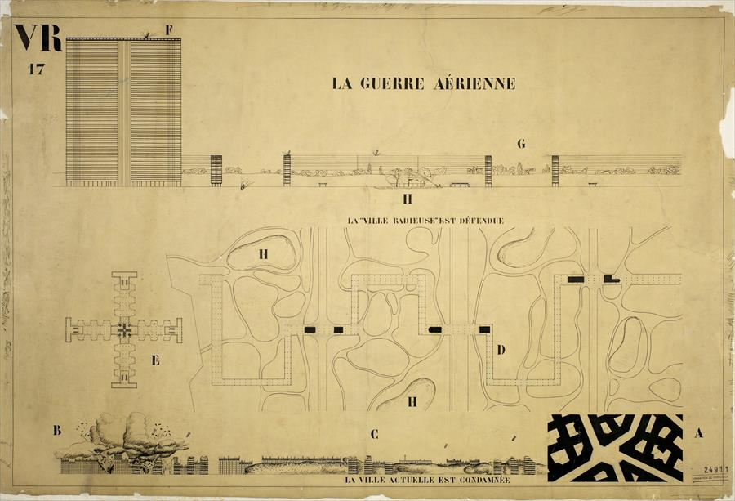
Ville Radieuse (1935)
‘Radiant City’

Slide 41
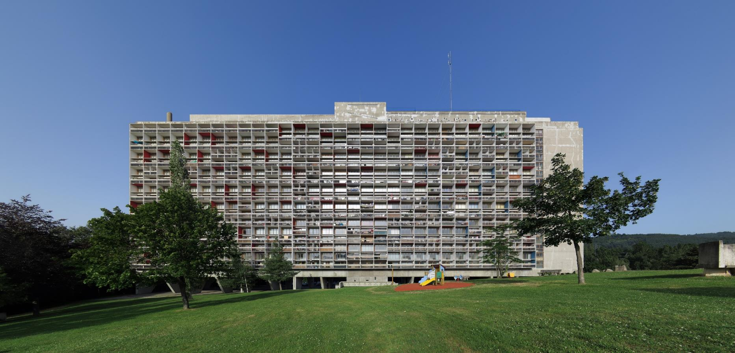
Unité d’habitation, Marseille, France (1952)
Notes:
Unité d’Habitation
Block housing as prototype
LC at 64 years, mature work at large scale
12 stories
Can be thought of as a synthesis between an accumulation of Villa Citrohan and an urban planning scheme in the vertical

Slide 42
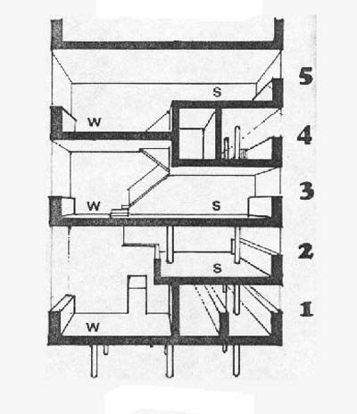
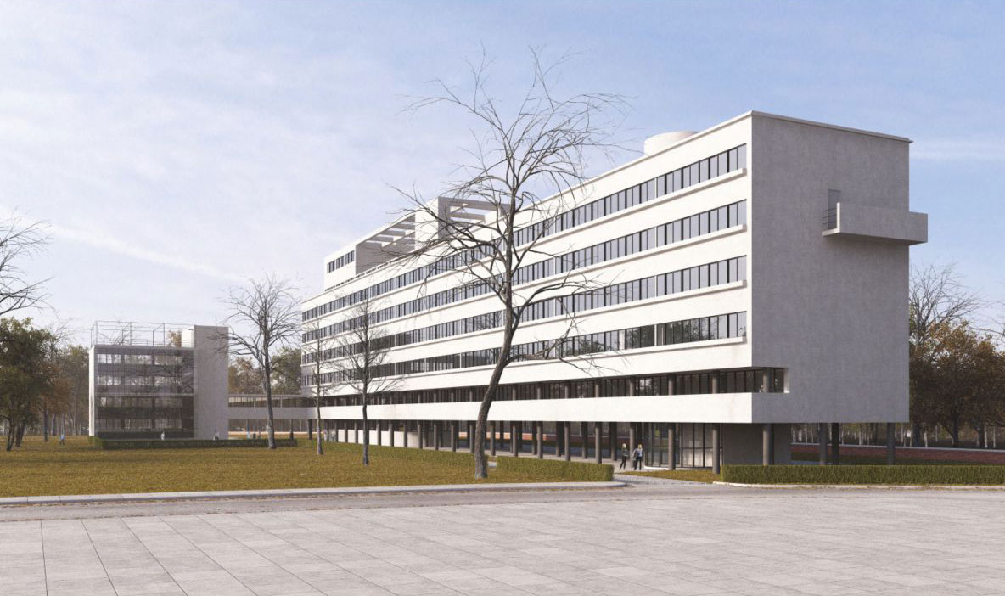
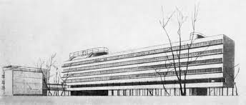
Moisei Ginzburg, Narkomfin Building, Moscow, Russia (1928)
Notes:
Largely influenced by its predecessor, from Russian architect Moisei Ginzburg

Slide 43
Marseilles, France (1952)
Nantes-Rezé, France (1955)
Berlin, Germany (1957)
Briey, France (1963)
Firminy-Vert, France (1965)

Slide 44
Marseilles, France (1952)
Nantes-Rezé, France (1955)
Berlin, Germany (1957)
Briey, France (1963)
Firminy-Vert, France (1965)

Slide 45
Marseilles, France (1952)
Nantes-Rezé, France (1955)
Berlin, Germany (1957)
Briey, France (1963)
Firminy-Vert, France (1965)

Slide 46
Marseilles, France (1952)
Nantes-Rezé, France (1955)
Berlin, Germany (1957)
Briey, France (1963)
Firminy-Vert, France (1965)

Slide 47
Marseilles, France (1952)
Nantes-Rezé, France (1955)
Berlin, Germany (1957)
Briey, France (1963)
Firminy-Vert, France (1965)

Slide 48
Unité d’habitation, Marseille, France (1952)
Notes:
Modularity of design

Slide 49
Unité d’habitation, Marseille, France (1952)
Notes:
Corridors running through spine
Units open on either upper or lower floor from the spine

Slide 50
Unité d’habitation, Marseille, France (1952)
Notes:
Massive pilotis

Slide 51
Unité d’habitation, Marseille, France (1952)
Ocean liner section, from La Ville Radieuse (1935)
Notes:
Clear comparison with an ocean liner, from Vers un Architecture

Slide 52
Notes:
Inset balconies, to accommodate for the changing position of the sun
Brise-soleil

Slide 53
Unité d’habitation, Marseille, France (1952)
Notes:
Each unit is double-height living room with terrace
23 different configurations, depending on size of family
Intended to show difference, even though through repetitive construction

Slide 54
Unité d’habitation, Marseille, France (1952)
Notes:
Roof terrace (recall the 5 Points)
Gymnasium
Crèche (nursery)
Ventilator stacks (like inverted pilotis)

Slide 55
Unité d’habitation, Marseille, France (1952)
Notes:
‘Elevated street’, public services (post office) and super market

Slide 56
a) the creation and development of bands of friendship between the inhabitants; b) the organization of collective activities (social, cultural, artistic and recreational); c) the defense, in all spheres, of the interests of its members, on all occasions when the interests in question were linked with the standard of living in the Unité; d) the participation of the inhabitants of the Unité in the determination of the material and moral administration of the Unité and its dependencies in an atmosphere of mutual understanding with all people who may be directly or indirectly interested.
Le Corbusier, Oeuvre complète, volume 7, 1957-1965

Slide 57
Chapelle Notre-Dame-du-Haut de Ronchamp, Ronchamp, France (1953 - 5)
Ronchamp Chapel
Notes:
Chapelle Notre-Dame-du-Haut de Ronchamp
Roman Catholic Chapel
Example of LC’s waning interest/dedication to Machine-Age aesthetic
Stands on the hilltop of the Vosges (VOJH) mountains
Highly irregular form that seems to change depending on where you’re situated

Slide 58
Chapelle Notre-Dame-du-Haut de Ronchamp, Ronchamp, France (1953 - 5)
Ronchamp Chapel
Notes:
Radical change in direction from his previous works
However are reminiscent of his paintings

Slide 59
Notes:
Massive walls emphasize this ambiguity

Slide 60
Chapelle Notre-Dame-du-Haut de Ronchamp, Ronchamp, France (1953 - 5)
Ronchamp Chapel

Slide 61
Chapelle Notre-Dame-du-Haut de Ronchamp, Ronchamp, France (1953 - 5)
Ronchamp Chapel

Slide 62
Chapelle Notre-Dame-du-Haut de Ronchamp, Ronchamp, France (1953 - 5)
Ronchamp Chapel

Slide 63
‘I have not experienced the miracle of faith but I have often known the miracle of inexpressible space, the apotheosis of plastic emotion’
Le Corbusier
Chapelle Notre-Dame-du-Haut de Ronchamp, Ronchamp, France (1953 - 5)
Ronchamp Chapel
Notes:
He himself was not religious, but was spiritual
Could be seen in references to ‘la mer’, ‘etoile’

Slide 64
Chapelle Notre-Dame-du-Haut de Ronchamp, Ronchamp, France (1953 - 5)
Ronchamp Chapel
Notes:
Quite a sculptural piece

Slide 65
Sainte Marie de La Tourette, Eveux-sur-l’Arbresle (Lyons), France (1953 – 1961)
La Tourette
Notes:
Sainte Marie de La Tourette
LC’s final building
While Ronchamp was under construction, was asked to design this monastery (Dominican)
Located in Lyons, France
Monastery/Priory
Allowed to sleep over (you should!)

Slide 66
Couvent Sainte Marie de La Tourette, Eveux-sur-l’Arbresle (Lyons), France (1953 – 1961)
La Tourette
Notes:
General form that of a courtyard – inward looking, community, even closed, common ideal purpose
Communal areas in lower areas
Public close to the entrance

Slide 67
Sainte Marie de La Tourette, Eveux-sur-l’Arbresle (Lyons), France (1953 – 1961)
La Tourette
Notes:
Mature work, not about a single idea, but many gestures into one building
Communal → society
Piloties
Roof/Courtyard Garden, one with nature

Slide 68
Béton brut
‘Raw concrete’
Sainte Marie de La Tourette, Eveux-sur-l’Arbresle (Lyons), France (1953 – 1961)
La Tourette
Notes:
Béton brut (‘raw concrete’)

Slide 69
Sainte Marie de La Tourette, Eveux-sur-l’Arbresle (Lyons), France (1953 – 1961)
La Tourette
Notes:
Even though for a closed community, was inspired by his ideals of living and work, and touched by the influence of spirituality

Slide 70
Sainte Marie de La Tourette, Eveux-sur-l’Arbresle (Lyons), France (1953 – 1961)
La Tourette

Slide 71
Sainte Marie de La Tourette, Eveux-sur-l’Arbresle (Lyons), France (1953 – 1961)
La Tourette

Slide 72
Sainte Marie de La Tourette, Eveux-sur-l’Arbresle (Lyons), France (1953 – 1961)
La Tourette

Slide 73
Sainte Marie de La Tourette, Eveux-sur-l’Arbresle (Lyons), France (1953 – 1961)
La Tourette

Slide 74
Ludwig Mies van der Rohe
German → American; 1886 - 1969
Notes:
Introduction
Last director of a famous arts school called the Bauhaus
Responsible for developing an architectural style that defined a number of decades of American corporatism
Works still define much of modern design and the urban landscape
‘glass box’ aesthetic
Worked for Peter Behrens, as did Le Corbusier
But would develop a much different aesthetic and theoretical approach

Slide 75
Grant Wood, American Gothic (1930)
Ernst Ludwig Kirchner, Street (1908)
Notes:
Adopted the idea of a Neue Sachlichkeit (New Objectivity)
Group of German artists in 1920s, reacting against Expressionism
Wanted to portray the art as a matter of fact
Not about Realism, but about using reality to express artistic idea
Often preferred static over dynamic compositions
While in painting the content was often political, in architecture it dealt with the use of material and visual tropes that defined the extant built environment

Slide 76
Kluczynski Federal Building, Chicago, Illinois (1974)

Slide 77
Brick Country House (1924)
Notes:
Brick Country House (1925)
Perfect diagram that summarizes his basic conception of architecture
Space as infinite, and architecture as a freezing of particular moments of this infinity

Slide 78
Le Corbusier, Unite d’habitation
Universality in Space versus
Notes:
- Unlike LC, modularity was not a principal concern for Mies

Slide 79
Exposicion Internacional Barcelona (1929)
Notes:
German/Barcelona Pavilion (1929)
Built as a temporary structure for the International Exhibition of 1929
1929 Barcelona International Exposition
20 May 1929 to 15 January 1930
Held in Montjuic area of Barcelona
City Planning, Technology, Arts, Agriculture, Science
A way for Spain to advertise its new advances
In addition, some countries invited to showcase their own, including countries such as:
Belgium
Denmark
France
Germany
UK
US
Japan

Slide 80
German Pavilion, Barcelona, Spain (1929 & 1986)
Barcelona Pavilion
Notes:
Represented Germany, under the Weimar Republic (1919 – 1933, the interwar period)
Wanted to represent openness, liberality, modernity, and internationalism
Pavilion taken down in 1930 as planned (exhibition timeline)
Rebuilt in 1986 due to ‘popular demand’
Not original pieces, as they were lost
Brings to question an important idea in architecture
Ship of Theseus

Slide 81
The building should ‘show what we can do, what we are, how we feel and see today. We do not want anything but clarity, simplicity and honesty.’
Georg von Schnitzler
Commissar General of the Reich

Slide 82
German Pavilion, Barcelona, Spain (1929 & 1986)
Barcelona Pavilion
Notes:
Roof slab supported by 8 cruciform steel columns clad in chrome
Hovering horizontal slabs (roof, podium)
Arguably considered his most ‘pure’ architectural example
In large part helps as it’s a pavilion, not constrained by certain functional aspects of his other buildings

Slide 83
German Pavilion, Barcelona, Spain (1929 & 1986)
Barcelona Pavilion
Notes:
Exemplar of the ‘International Style’
Not about place, but about a transcendent truth to architectural form
Some walls are load-bearing, but their roles are principally spatial rather than structural

Slide 84
German Pavilion, Barcelona, Spain (1929 & 1986)
Barcelona Pavilion
Notes:
- Many compare it with a Mondrian, but I think it has a certain tactility that separates it from the De Stijl notion of ‘purity’, although shared concept of the infinite in form

Slide 85
German Pavilion, Barcelona, Spain (1929 & 1986)
Barcelona Pavilion
Notes:
- Model from MOMA collection, Barcelona Pavilion Replacement Fund

Slide 86
German Pavilion, Barcelona, Spain (1929 & 1986)
Barcelona Pavilion
Notes:
Cross section of cruciform column
Constructed from ‘regular’ materials
4 Angle irons (90 degree extrusions)
Bolted together
With polished steel sleeve

Slide 87
Sketches for cruciform column

Slide 88
German Pavilion, Barcelona, Spain (1929 & 1986)
Barcelona Pavilion
Notes:
Not just a construction detail, but summarizes his notion of form
Column as framing an intersection of infinites lines/planes

Slide 89
German Pavilion, Barcelona, Spain (1929 & 1986)
Barcelona Pavilion
Notes:
- Photograph of underside of actual column

Slide 90
German Pavilion, Barcelona, Spain (1929 & 1986)
Barcelona Pavilion
Notes:
Like Wright, Mies’ sketches spoke the same language as his buildings
About infinite spaces – planes floating and crossing each other – not about boundary but about condensations of form

Slide 91
Farnsworth House, Plano, Illinois (1951)
Notes:
Farnsworth House [1951]
Weekend home for Dr. Edith Farnsworth
About a 1.5 drive away from Chicago
‘Domestic pavilion’ in nature
Clear hovering horizontal planes, more so than the Barcelona Pavilion
Regrettably the role of the curtains doesn’t come out as much in the drawings
Curtains were used for his collaborative project with Lilly Reich
This idea was taken to its fullest with Mies
Rarity in which white was used as the dominant color
Often black or rusted copper

Slide 92
Farnsworth House, Plano, Illinois (1951)
Notes:
- Typical Miesian plan – dominance of rectangular forms

Slide 93
Farnsworth House, Plano, Illinois (1951)
Notes:
As with the section
Notice that the tapered beam framing under concrete flooring
Of course for Mies, this wouldn’t be included on the roofs, as this would distract from orthogonality of structural forms

Slide 94
Farnsworth House, Plano, Illinois (1951)
Notes:
- My reading, the house is based off of ‘scenes’, an approach that comes to define much of his working method

Slide 95
Farnsworth House, Plano, Illinois (1951)
Notes:
In terms of size, relatively modest, but remember that this was Dr. Farnsworth’s weekend retreat
Open plan, no walls fully enclosing spaces except bathrooms
Notice river running in the background

Slide 96
Farnsworth House, Plano, Illinois (1951)
Notes:
- Modest 1 bedroom, with kitchen to right of photo

Slide 97
Farnsworth House, Plano, Illinois (1951)
Notes:
Entire house was raised, as the river regularly flooded (and still does)
Conceptually however, this reinforces this idea of form as floating, not ‘grounded’

Slide 98
Farnsworth House, Plano, Illinois (1951)
Notes:
Example of level of flooding… not a great site for this kind of structure

Slide 99
Farnsworth House, Plano, Illinois (1951)
Notes:
And by flooding… it wasn’t built high enough!

Slide 100
Illinois Institute of Technology, Chicago, Illinois (1940s – 1970s)
Notes:
Illinois Institute of Technology / SR Crown Hall [1956]
Soon after his immigration to the US
Mies was chair of Architecture department from 1938 – 1958
Redesigned Amour Institute, later named Illinois Institute of Technology
Mies was given carte blanche for the commission

Slide 101
Illinois Institute of Technology, Chicago, Illinois (1940s – 1970s)
Notes:
- A more recent photograph, with the campus toward the foreground and downtown Chicago in the background

Slide 102
Illinois Institute of Technology, Chicago, Illinois (1940s – 1970s)
Notes:
Radical departure from typical campus layout
Both in overall layout and materiality
Main buildings perched on a podium, while those of lesser attention touched the ground
The language of the buildings are often likened to a factory aesthetics – a factory for learning, research, and development
Have to remember that unlike Mountaintop, these were new builds that were not industrial to begin with – so an aesthetic

Slide 103
Ludwig Mies van der Rohe
Skidmore, Owing, and Merrill
Minerals and Metals Research Building (1943, 58)
Engineering Research Building (1945)
Alumni Memorial Hall (1946)
Wishnick Hall (1946)
Persletin Hall (1947)
Heating Plant (1949)
Institute of Gas Technology Complex (1949, 55)
American Association of Railroads Complex (1955)
Carr Memorial Chapel (1952)
Commons Building (1954)
Baily, Carman, Cunningham Halls (1953 – 55)
SR Crown Hall (1956)
Siegel Hall (1957)
[Walter Netsch]
Paul V. Galvin Library (1962)
Gover M. Hermann Hall (1962)
[Myron Goldsmith]
Keating Hall (1966)
John T. Rettaliata Engineering Center (1968)
Robert A. Pritzker Science Center (1969)
Stuart Building (1971)
Illinois Institute of Technology, Chicago, Illinois (1956)
Notes:
Not all buildings were completed by Mies, given over to SOM (but still w/ Mies’ style)

Slide 104
Ludwis Mies van der Rohe, Crown Hall (1956)
Walter Netsch, Grover Hermann Hall (1962)
Notes:
Buildings later designed by SOM would clearly ‘bite’ from Mies’ design language… more on that in a later section

Slide 105
Illinois Institute of Technology, Chicago, Illinois (1956)
Notes:
Crown Hall
Clear design kinship between Farnsworth House and Crown Hall… like most of his buildings
Elevated box with clear procession
Repetitive structural frame
From steel plate girders welded together
Notion of infinite repetition
Protruding from the roof line
For Mies, structure was used principally as an aesthetic device

Slide 106
Ludwig Mies van der Rohe, Crown Hall (1956)
Notes:
Lack of internal structural support to facilitate mobility of furnishings
Mobility important for an academic hall serving multiple functions

Slide 107
Ludwig Mies van der Rohe, Crown Hall (1956)
Notes:
Additional space into the basement
A common Miesian layout – big open ground floor, with a basement for more programmed spaces

Slide 108
Ludwig Mies van der Rohe, Crown Hall (1956)
Notes:
Pay attention to treatment of nature – the building frames the space around it
Despite universality of form, strong generic consideration of the exterior

Slide 109
Seagram Building, 375 Park Ave, New York City (1958)
w/ Philip Johnson
Notes:
Seagram Building [1958]
One of the most important early skyscrapers
Largely defined image of the American skyscraper, and spawned countless copies
Novelty in planning (plaza + setback)

Slide 110
Notes:
Structure comprised of 2 parts
Main tower
And rear low-rise
Up until recently, housed the famous Four Seasons Restaurant

Slide 111
Notes:
More detailed view of the typical plan of the tower
Of course, corner offices dedicated to more senior positions
Notice the tower’s cores towards the upper half of the plan – in most towers, these will largely dictate and constrain the kinds of possible spaces throughout

Slide 112
Seagram Building, 375 Park Ave, New York City (1958)
w/ Philip Johnson
Notes:
- A lot of copycats, the giveaway is to look for the service floors at the crown, a well as the layout of the front plaza

Slide 113
Seagram Building, 375 Park Ave, New York City (1958)
w/ Philip Johnson
Notes:
Fluorescent full-tile ceilings reinforce ‘floating planes idea’

Slide 114
Seagram Building, 375 Park Ave, New York City (1958)
w/ Philip Johnson
Notes:
Should be thought of as a ‘high-spec’ tower
Amber windows
Rust-colored bronze
Travertine and polished green marble

Slide 115
Seagram Building, 375 Park Ave, New York City (1958)
w/ Philip Johnson
Notes:
Decorative aspects
Attached extrusions on outer envelope
Not structural, but aesthetic
The idea that machine production had aesthetic merit on its own
Similar plinth as BCN Pavilion (travertine)
One of the most important aspects of this building however is what ‘isn’t there’… the plaza

Slide 116
Notes:
Revision of 1916 zoning law, into 1961 new zoning resolution
Extra height for more public space
Encouraged privately owned public space to open up the densification of urban development
Changed the ‘image’ of the NYC skyline to what we see today

Slide 117
Notes:
- Examples of the ‘ziggurat’ or ‘wedding-cake’ style skyscraper that dominated early city building in the US

Slide 118
SOM, Lever House, 390 Park Ave, New York City (1982)
Seagram Building, 375 Park Ave, New York City (1958)
w/ Philip Johnson
Notes:
- Lever House by SOM (again), a variation of ‘offering’ public space for additional building height

Slide 119
Neue Nationalgalerie, Berlin, Germany (1968)
The New National Gallery
Notes:
Nationalgalerie [1968]
Design of a gallery dedicated to 20th century art
Last work before passing in 1969

Slide 120
Verwaltungsgebäude Ron Bacardi, Santiago de Cuba, Cuba (1957 - 60)
Administration Building for Bacardi Rum
Notes:
The evolution of the Nationalgalerie reveals Mies’ quintessential approach to architecture as the design of universal forms
Originally the design for Bacardi Rum’s headquarters in Santiago de Cuba, but was never initiated because of the Cuban Revolution
The Bacardi family’s assets were seized in 1960
Well-known that Bacardi had commissioned Mies to design an ‘office without walls’
Site-specificity not at all a principal concern

Slide 121
Verwaltungsgebäude Ron Bacardi, Santiago de Cuba, Cuba (1957 - 60)
Administration Building for Bacardi Rum
Notes:
- Sketches of Bacardi headquarters

Slide 122
Bacardi Administration Building, Santiago de Cuba, Cuba (1957)
Notes:
Interior rendering of Bacardi

Slide 123
Verwaltungsgebäude Ron Bacardi, Santiago, Cuba (1957 - 60)
Administration Building for Bacardi Rum
Notes:
Careful placement of the columns
Don’t touch corners, emphasizing expansion of the horizontal ‘floating’ plane, rather than static stability
Infinite planes
Almost 30 feet in height

Slide 124
Verwaltungsgebäude Ron Bacardi, Santiago, Cuba (1957 - 60)
Administration Building for Bacardi Rum
Notes:
- General views, showing changing grade of site looking at various staircase processions

Slide 125
Neue Nationalgalerie, Berlin, Germany (1968)
The New National Gallery
Notes:
Comparison with this building to those of IIT, this one is far more important – has a civic purpose
Hence the large surrounding plaza
Can be ‘cut’ without entry into building
Building ‘serves’ the city w/o entrance

Slide 126
Neue Nationalgalerie, Berlin, Germany (1968)
The New National Gallery
Notes:
RCP
Ceiling grid of about 12 ft
Clear span across
Just over 200’ span

Slide 127
Neue Nationalgalerie, Berlin, Germany (1968)
The New National Gallery
Notes:
Lower floor is mainly for permanent collection, while the upper floor is for rotating exhibitions
Upper not meant to be entirely filled
Notice Mies’ Barcelona furniture towards foreground of photo
Lack of full-height walls

Slide 128
Neue Nationalgalerie, Berlin, Germany (1968)
The New National Gallery
Notes:
Underside of roof recalls coffered ceiling
And placement of building elevated relative to street, emphasize the palatial quality of the building
Monumentality
In his terms, it was like a ‘temple’
As shown in this photo, when visiting the building in person, easy to see straight-through
Jewel box atop a podium

Slide 129
Neue Nationalgalerie, Berlin, Germany (1968)
The New National Gallery
Notes:
Essentially being a large shed, degrees of internal/external relations
Inside the ground floor of the museum is a kind of controlled landscape, with entrances to basement almost concealed
A reason why Mies’ work epitomized the ‘International Style’ was because it really didn’t matter where his projects were

Slide 130
Neue Nationalgalerie, Berlin, Germany (1968)
The New National Gallery
Notes:
Drawings
Approach to universality of form extended into his renderings as well
Universal concepts in space
That’s not to say he didn’t cater his designs for his clients’ needs, but in many ways, he universalized them
A client’s use for their kitchen or bedroom became a universal problem of living

Slide 131
Resor House, Jackson Hole, Wyoming (1943)
Notes:
- So framing nature wasn’t about how a particular house would frame its particular environment, but about the general, or universal, problem of framing

Slide 132
Resor House, Jackson Hole, Wyoming (1943)

Slide 133
Resor House, Jackson Hole, Wyoming (1943)

